Slide 1


HTML & CSS: FUNDAMENTALS OF DEVELOPMENT
Instructor: Aaron Bronow Week 2

Slide 2

SESSION OVERVIEW
Week One review and questions
Overview of CSS – font styling, colors, alignment
File organization
Version control and code sharing with Git
Background images and gradients with CSS

Slide 3

REVIEW!

Slide 4



REVIEW: WEBPAGE COMPONENTS
html
Structures and organizes content
css
Styles the markup and creates layout
Javascript
Brings content and design to life

Slide 5
REVIEW: HTML DOCUMENTS
<!DOCTYPE html> tells the browser it's serving an HTML file using HTML5 standards
<html> wraps the whole document
<head> wraps the metadata and styles
<body> wraps the visible content
Most HTML elements have opening and closing tags and some have attributes

Slide 6
REVIEW: layout elements
<header> wraps header content
<footer> wraps footer content
<nav> indicates that everything inside is related to navigation
<section> is used to define content sections

Slide 7
REVIEW: HTML CONTENT
Headings create an header/outline
<h1>...<h6>
Paragraphs and lists structure text
<p>
<ul>
<ol>
Images and links both require attributes to work

Slide 8
Review: IMAGES
<img src="kitten.jpg" alt="Cute kitten" />
Does not have a closing tag (“self-closing”)
Two required attributes:
src is where the file lives (local or external)
alt is a description of the image (used for screen readers, search engines, etc.)

Slide 9
Review: Links
<a href="http://google.com">Google</a>
Creates a link to other pages or websites
The href attribute says where the link should go
Anything inside <a> tags is clickable

Slide 10
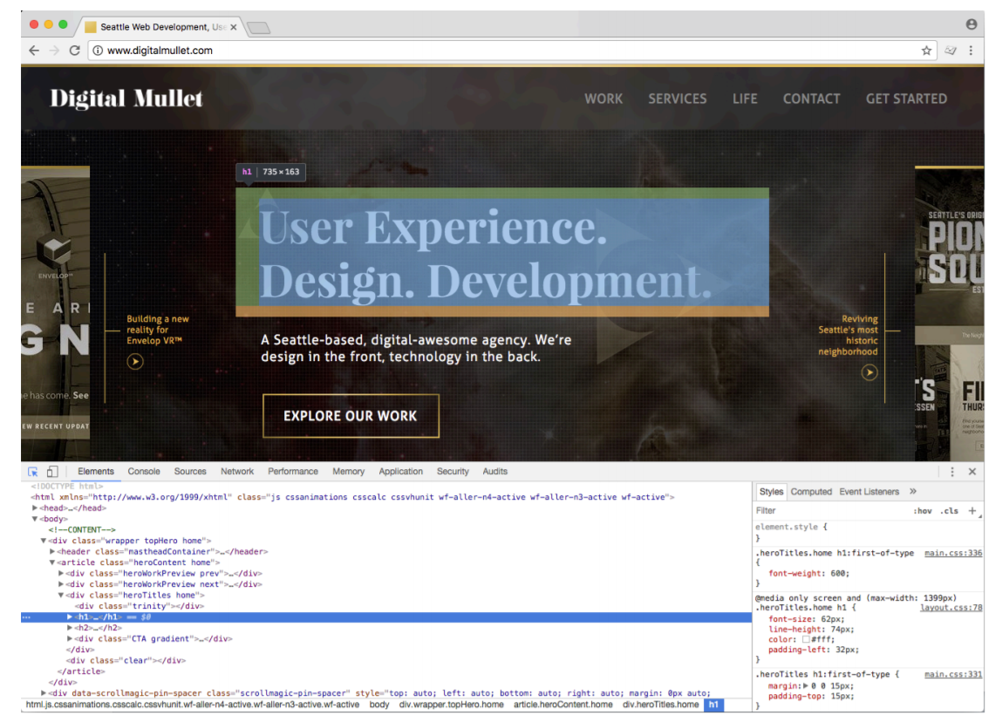
Review: Dev tools
Right-click > Inspect, or hit the F12 key

Slide 11
QUESTIONS?

Slide 12


Slide 13
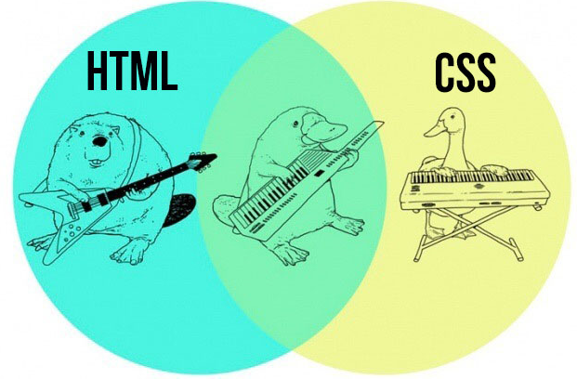
html + CSS = WEBPAGE

Slide 14
CASCADING STYLE SHEETS
CSS is a language for specifying how documents are presented to users
Allows us to override the browser’s default presentation styles with a custom version
Provides consistent and scalable ways to style single elements, single pages, or entire websites
Separates look and feel from content/markup

Slide 15
CSS: FAIR WARNING
There is A LOT you can do with CSS
We won’t get anywhere close to covering everything!
We will cover CSS for text styles, colors, positioning, layout, and a couple of extras

Slide 16
WHY USE CSS?
Helps you avoid duplication by keeping styles in one place (one external stylesheet)
Makes style maintenance easier - for example, update the font for the whole site in one line of code!
Separating presentation from content enforces style consistency and allows flexibility

Slide 17
Css goes where?
CSS is a different type of language than the HTML we did last week, and has its own syntax
CSS can go directly in your HTML file, inside a <style></style> element
You can also create a “.css” file that can be linked to your HTML page

Slide 18
ANATOMY OF A CSS RULE
selector { property: value; }
selector is the thing you want to style
property is the attribute you want to style
value is how you want to style it
Values always end in semicolons (;)

Slide 19
ANATOMY OF A CSS RULE
So!
<style>
p { color: blue; }
</style>
"All paragraphs will have blue text "

Slide 20
EXAMPLE CSS RULE
p { color: blue; }
selector is p (all <p> tags in the HTML)
property is color
value is blue (many color names are supported, or use the hex code #0000ff)
Notes:
Look up hex code for blue

Slide 21
EXAMPLE CSS RULE
p {
color: blue;
font-size: 14px;
}
Multiple properties can be defined for a single selector, each separated by a semicolon (;)
Notes:
Look up hex code for blue

Slide 22

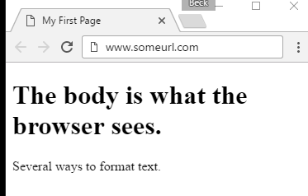
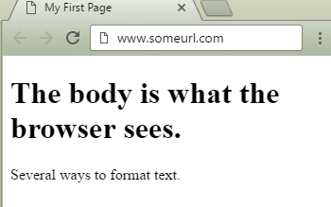
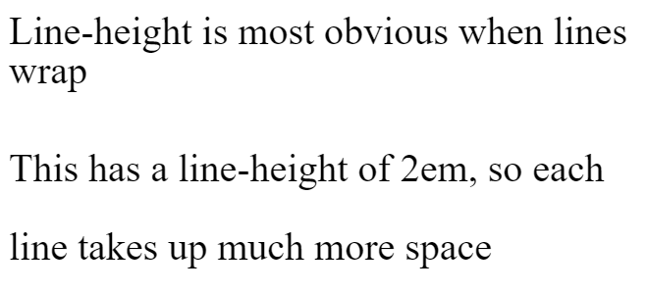
{ } Common font Properties
line-height: a number followed by a measurement of the height of a line of that element, in ems (em) or pixels (px)
similar to leading in typography
p { line-height: 1.4em; }
font-size: a number followed by a measurement of the height of that element’s text in ems (em) or pixels (px)
p { font-size: 14px; }
Notes:
Website live example

Slide 23
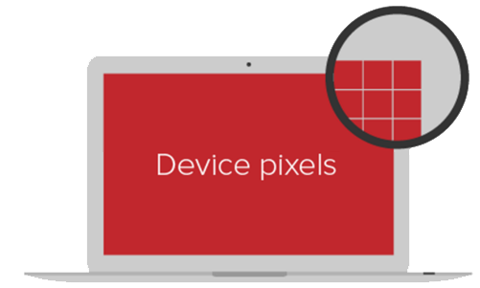
{ } Quick aside about units
The two standard units for sizing in CSS are px and em
px is an abstract unit that isn’t related to font height and isn’t a physical unit of measurement
Devices with more PPI (pixels per inch) may use several “device” pixels when displaying a 1px line
That means that px size varies by device, but should always look "about the same"

Slide 24
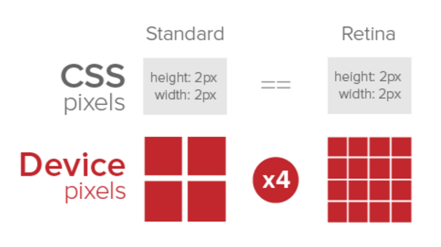
{ } Quick aside about units

Slide 25
{ } ah-em
em refers to the height of the letter 'm' of the font being used
This unit of measurement is a description of the relative size between this element and its parent
So h2 { font-size: 2em; } means the header is 2 times as big as the letter 'm' of the default font in your html document

Slide 26
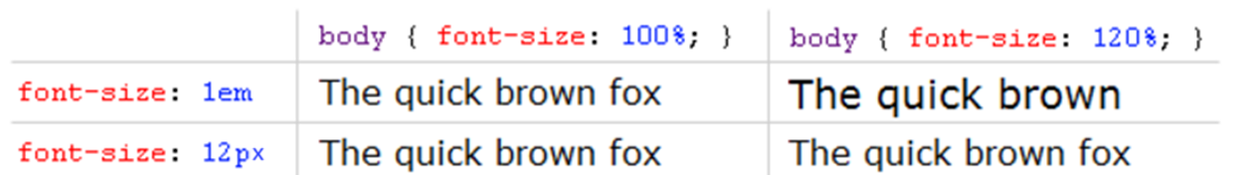
{ } That wasn’t quick
Because em is relative, that means that if the parent’s font size is increased, the children will get bigger too.

Slide 27
{ } Common font Properties
font-style: normal by default – can also be italic or oblique
font-weight: normal by default – can also be bold, or values of 100, 200, etc. (depending on the typeface)
font-family: the name of a typeface installed on the user's computer
p { font-family: Arial, Helvetica, sans-serif;
}
The W3 has a list of “web safe” fonts that most people will have installed locally

Slide 28

{ } font transform
text-transform: changes font casing. Can be uppercase (all caps), lowercase, or capitalize (first letter of all words capitalized)
letter-spacing: change font kerning by specifying the space between letters in ems (em) or pixels (px)
p { font-family: Arial;
text-transform: uppercase;
letter-spacing: 2.4px;
}

Slide 29
{ } Colors
color: changes the color of text
background-color: sets the background color of an element
Color value can be set using names, HEX, RGB, or RGBA
Name: white
Hex: #ffffff
• RGB: rgb(255, 255, 255)
• RGBA: rgba(255, 255, 255, 0.8)
Notes:
256?

Slide 30
{ } Color examples
p { color: black;
}
p { background-color: #000000;
}
p { background-color: rgb(0, 0, 0);
}
Notes:
256?

Slide 31

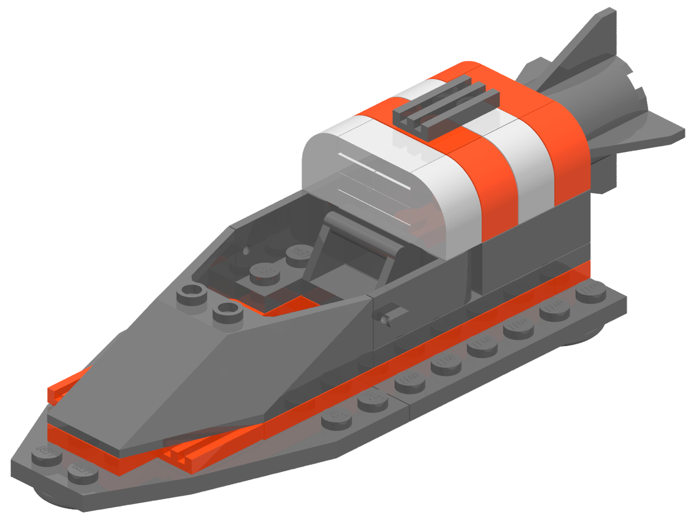


{ } four link states
You can style a link differently depending on what state it’s in
a:link
a:visited
a:hover
a:active

Slide 32
{ } four link states
a { color: blue; }
a:visited { color: gray; }
a:hover { color: purple; }
a:active { color: yellow; }
Let’s inspect a live demo of how this looks

Slide 33
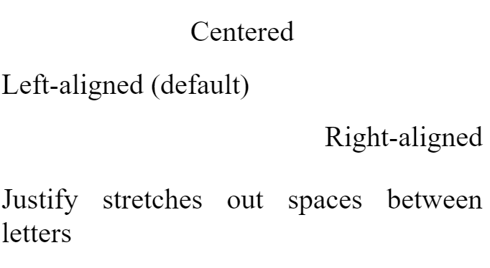
{ } Text-align
You can change the alignment of text using the
text-align property.
Values:
center
left
right
justify
h1 { text-align: center; }

Slide 34
{ } Multiple selectors & Properties
You can add multiple selectors to a CSS rule
You can add multiple properties to a CSS rule
<style>
ul {
color: #ffffff;
}
ol {
font-size: 16px;
font-weight: bold;
color: #444444;
}
</style>

Slide 35
{ } CSS COMMENTS
Just like HTML, CSS can have comments
Start with /*
End with */
<style>
/* I am a CSS comment! */
</style>

Slide 36
PRACTICE TIME!

Slide 37
Practice
Add a <style></style> section in the <head> on your page
Make some style changes using CSS
Consider changing font color, font family, font size, link color, text alignment, and background colors

Slide 38

FILE ORGANIZATION

Slide 39
FILE ORGANIZATION
If you structure your site correctly, you are one step closer to faster updates
Structure should be not just for you, but for anyone who might use, need or want any of your files (images, scripts, stylesheets, etc)
The next person to work on or look at your code will be able to understand what you’ve done and where to find things

Slide 40
FILE ORGANIZATION
Typical files in a website include:
HTML files (.html)
CSS files (.css)
Javascript files (.js)
Images (.png, .jpg, .gif)
HTML should usually go in the main (root) directory
Make subdirectories for media, CSS, and Javascript files

Slide 41
FILE Naming RULES
Use a consistent naming convention when naming files and folders
For example, always all lowercase, or words always separated by dashes, etc
Capitalization matters
INDEX.html is not the same as index.html
Use only letters, numbers, hyphens (-) or underscores (_)
No spaces in file names

Slide 42
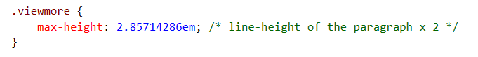
Code organization
Comment your files – especially if you have unfinished development code, or if you think you may forget why you made the decision you did
Indent your code (trust me)

Slide 43
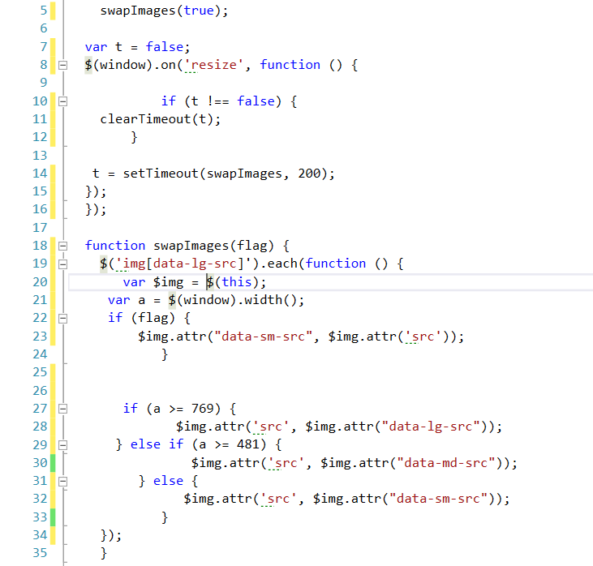
Code indentation
The Javascript code on the right doesn’t have consistent formatting, and is hard to read

Slide 44
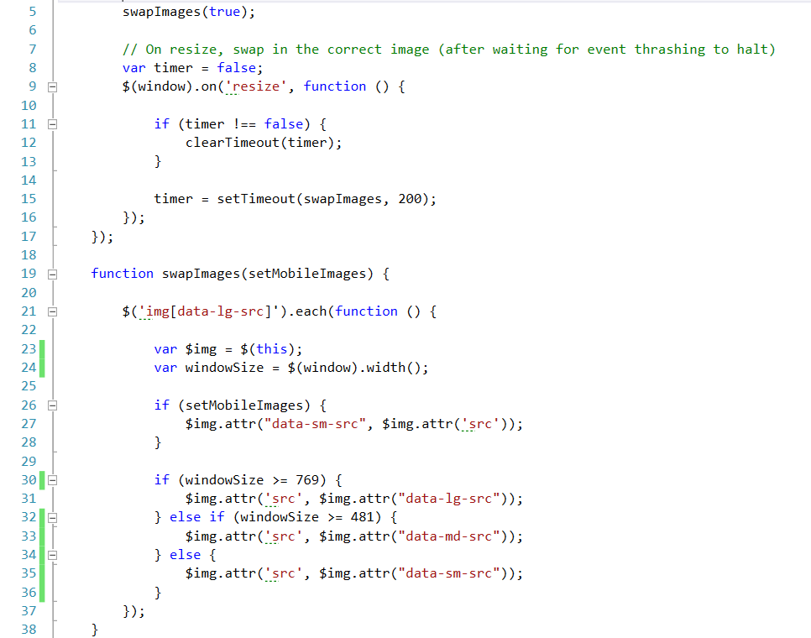
Code indentation
This code is indented, so it’s easier to see the “if/else” logic
Comments are added to explain decisions

Slide 45
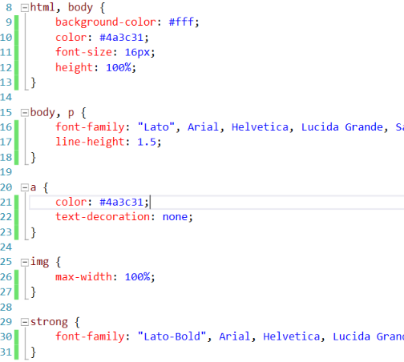
css indentation
This is one popular way to indent CSS
Starting bracket is on the same line as the selector
Each property is on its own tabbed line
Ending bracket is on its own line

Slide 46
PRACTICE TIME!

Slide 47
assignment
Create a folder for your images, and move all images there
Fix the paths in all your <img src> tags so that images show like before
Remember the different between relative and absolute paths
Prettify your CSS and HTML so that it’s easy to read

Slide 49
{} CSS in multiple places
So far, we’ve been making CSS changes directly on a single webpage, in the <head> element.
These internal styles only apply to that page (but affect every element on that page that is styled)

Slide 50
{} CSS in multiple places
You can also add inline styles to a single element by using the style attribute in HTML markup
<p style="color: red">This paragraph is special.</p>
Inside the style attribute, use the same syntax as CSS (selector: value)
Typically discouraged, because it can be hard to maintain

Slide 51
{} CSS IN MULTIPLE PLACES
The most common way to use CSS in “real life” is to use an external stylesheet.
CSS lives in a separate .css file
The same stylesheet can be included on multiple pages
A single page can include multiple stylesheets

Slide 52
{} Linking to external stylesheet
<link href="css/styles.css" rel="stylesheet">
Tells the browser to find and load the styles.css file from the css directory
The rel attribute stands for "relation" - in this case, this link's relationship to the document is "stylesheet"
This tag goes inside the <head> element
Should be on every page that needs the styles

Slide 53
{} The “CASCADING” Part
The beauty of CSS is being able to create styles and then override them when you want to customize the look of your pages.
There are 3 rules for determining how styles get applied:
Styles are applied from far to near
Styles are applied from top to bottom
Children elements are more specific than parents

Slide 54
{} far to near
Styles that are “closer” to the elements they style take precedence.
Browser defaults
External styles (in a .css file)
Internal styles (in the <head>)
Inline styles (directly on an element)
Less Specific
More Specific

Slide 55




{} far to near
Browser default
External styles
(in a .css file)
Internal styles
(in the <head>)
Inline styles
(directly on an element)
Less specific to more specific

Slide 56
{} Top to bottom
CSS rules are applied sequentially
If the same property is styled multiple times for the same selector, the last one wins
p | { | color: | #2f4251; | }
p | { | color: | #daa645; | } | /* | this | one | wins | */

Slide 57
{} Children are specific
Children elements usually inherit styles from their parents, but can override parents with their own styles
p { color: #daa645; } /* all paragraphs */
b { color: #e7c0c8; } /* bold text in general */
p b { color: #c4fe46; } /* bold text in paragraphs */

Slide 58
PRACTICE TIME!

Slide 59
{ } External Stylesheets
Create a folder for css, then create a new file in that folder called styles.css
Copy and paste the styles from inside <style></style> into that file
Remove the styles from the <style></style> tag
Create a link to your new stylesheet on all of your webpages:
<link href="css/styles.css" rel="stylesheet">
Does everything still look the same?

Slide 60

Version control

Slide 61




Version control
In modern development, most websites are a team effort.
Version control systems (VCS) allow multiple people to work on the same file with less risk of overriding changes.

Slide 62
git
is a free, open-source version-control system
Git is software that tracks any changes that you (or anyone else) make to a project
A project contains every file and subdirectory inside a folder
The “master copy” of the project is stored on a remote server
You can download a copy of the project from the server, create new versions of the project, and also have access to every version (of every file!) saved along the way

Slide 63
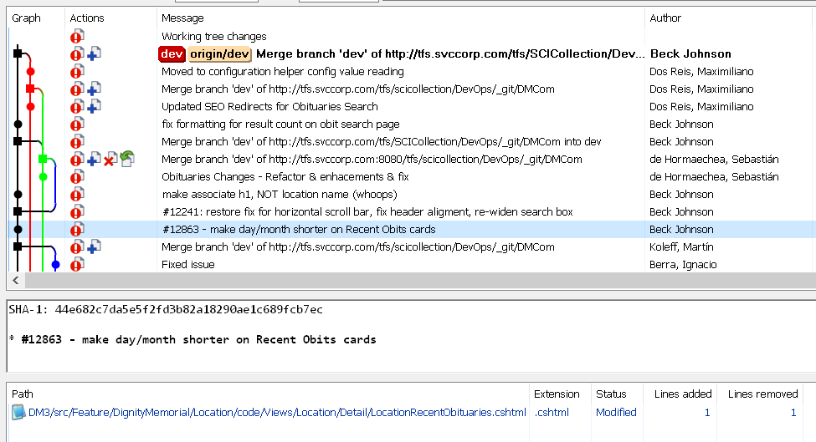
git
When you upload changes to the remote server, you can add a friendly message indicating what you changed:

Slide 64

github
GitHub.com is a free online hosting provider for code that is tracked using Git
Code is stored publicly (unless you want to pay extra)
Very popular storage place for open-source projects
The website for this class is hosted by GitHub!

Slide 65

BACKGROUND images

Slide 66
BACKGROUND COLOR review
p {
background-color: gray;
color: white;
}
This is a paragraph with the background color set to gray.

Slide 67
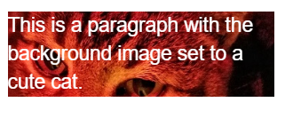
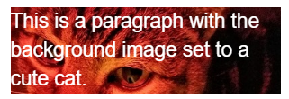
BACKGROUND IMAGES
Can set background of an element as an image (instead of a color) with the property background-image
The value is url("path"), where path is the relative or absolute path to where the image lives, like this:
p {
background-image: url("images/kitten.jpg");
color: white;
}

Slide 68
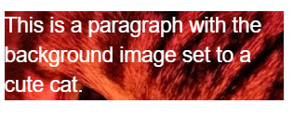
BACKGROUND IMAGES
p {
background-image: url("images/kitten.jpg");
color: white;
}
The amount of image that displays in the background is calculated based on image size and container size.
Make sure to resize images so that the part you want visible is within the “view window”
Or…

Slide 69

BACKGROUND POSITION EXAMPLES
background-position: allows you to move a background image around within its container
By default, an image is positioned at the top left side of the container
section {
background-image: url("octopus.jpg");
background-position: top left;
}
Image width: 600px by 800px

Slide 70
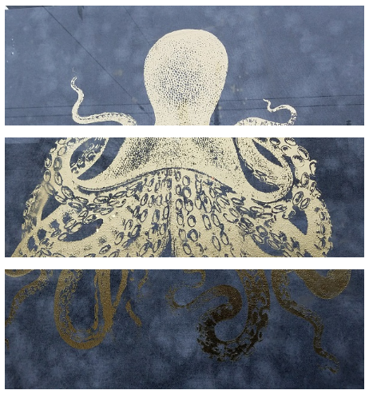
BACKGROUND POSITION EXAMPLES
Container width: 600px by 200px
background-position: top left;
background-position: center center;
background-position: bottom right;

Slide 71
BACKGROUND repeat
background-repeat: defines if (and how) the background image will repeat
By default, background images are repeated until they fill the entire container
p {
background-image: url("codepen.gif");
background-repeat: repeat;
}

Slide 72

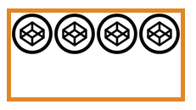


BACKGROUND repeat
repeat: tile the image in both directions
repeat-x: tile the image horizontally
repeat-y: tile the image vertically
no-repeat: don't repeat, just show the
image once

Slide 73
BACKGROUND attachment
background-attachment: images usually scroll with the main view, but setting to fixed means the image stays in place when the user scrolls the page
Difficult to describe, so check out this demo or this demo
section {
background-image: url("pattern.png");
background-attachment: fixed;
}

Slide 74
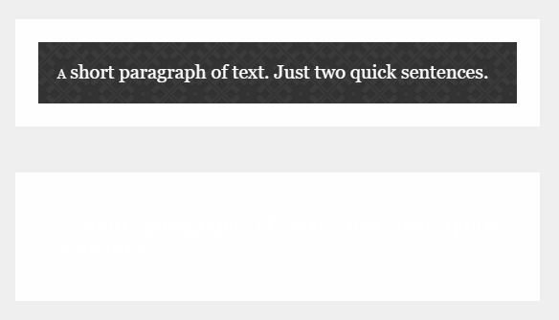
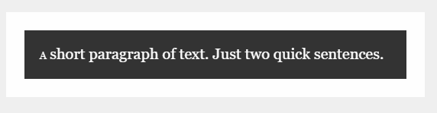
Fallback BACKGROUND color
If your background image is dark and your text is light
You may want to specify a background-color in addition to a background-image so that content is visible while the image is loading
So instead of a “blank” area…
…the user can see content while the image downloads

Slide 75


Background gradients
You can set background-image to linear-gradient, which is a gradient that the browser draws for you:
section { background: linear-gradient(black, white); }
As many colors as you want can be blended, separated by commas:
section {
background: linear-gradient(#ea992e, red, #9e5308);
}

Slide 76


Background gradients
By default linear-gradient draws from top to bottom, but you can set the gradient to draw at an angle instead by starting with to
section { background: linear-gradient(to bottom right, black, white); }
section {
background: linear-gradient(to right, red, #f06d06, yellow, green);
}

Slide 77

Background gradients
Background gradients can use rgba colors, meaning you can create a gradient that fades to transparent:
body {
background-image: url("flowers.png");
}
header {
background-image: linear-gradient(to right, rgba(255,255,255,0), rgba(255,255,255,1));
}

Slide 78
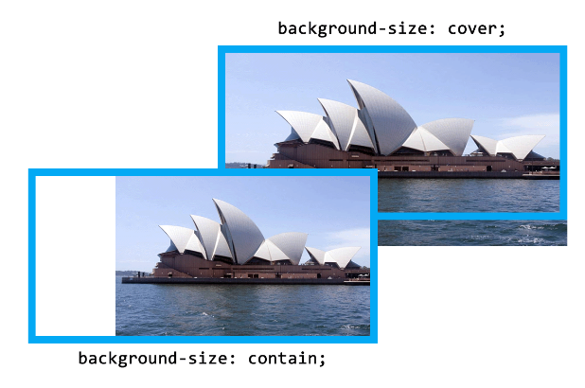
BACKGROUND size
background-size: specifies how much of the container that the image covers
cover: always cover the entire container (even if that means cropping an edge, or stretching the image)
contain: always show the whole image (even if that means there is space on the sides or bottom)

Slide 79
Height and width
To ensure that a background image fully displays, you can set the height (and/or width) attribute on the element using CSS:
header {
background-image: url("images/hero.png");
height: 600px;
}

Slide 80
Height and width
height and width can be set on (most) elements to change how much room they take up on the page.
We’ll discuss later why elements like <a> and <em> don’t change when you set their height or width
The value of this property must be a positive number.
Units are either px or em
Or you can specify a percentage
header { height: 6em; }

Slide 81
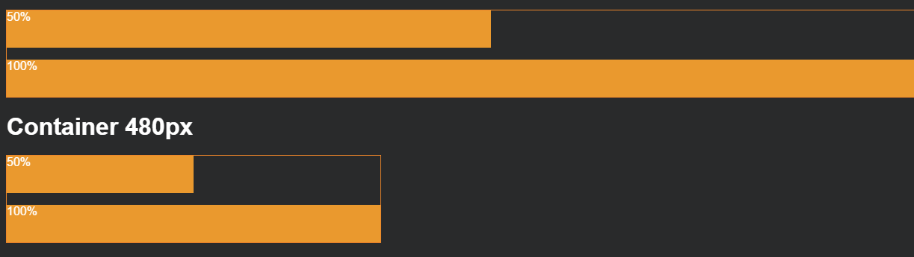
Height and width %
Percentage is based on the element’s parent’s width or height
section { width: 50%; }
If that section were inside a 480 px wide container, it would end up being 240 px wide.

Slide 82
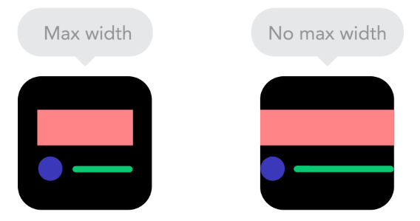
Max-Height and max-width
To ensure an element is never larger than a certain value, use max-height or max-width
Typically used to make sure content (particularly text) doesn’t spread too far out on large monitors

Slide 83
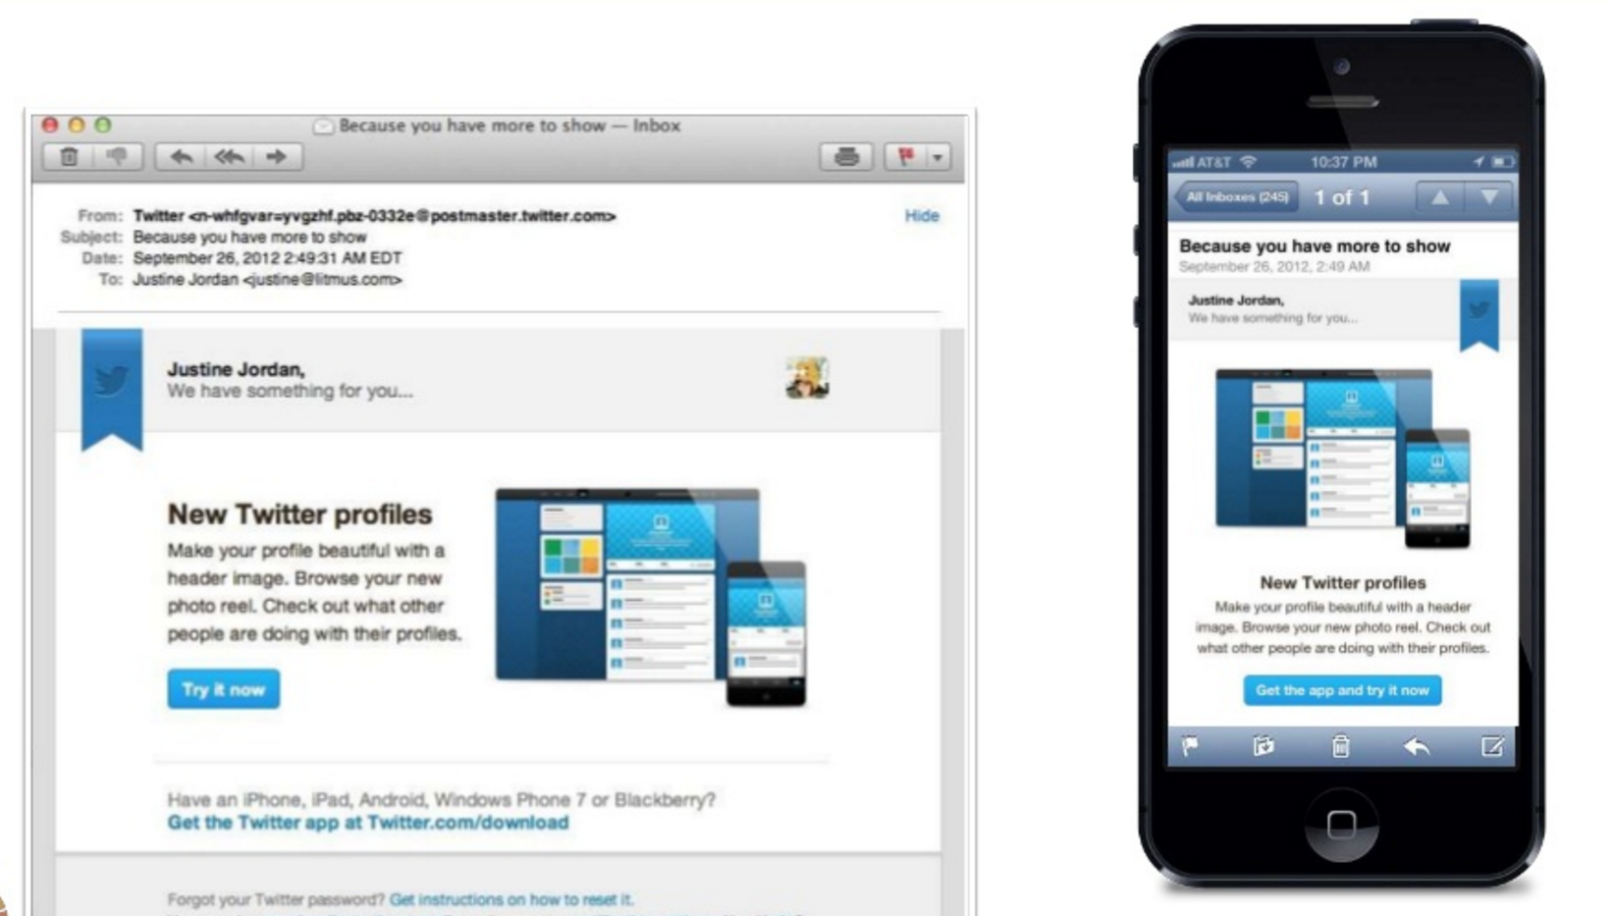
Min-Height and min-width
Specify min-height or min-width if you want to ensure an element is never smaller than a certain value.
This is especially helpful if your size is “dynamic” (based on percentage) and will vary depending on device
img {
width: 50%;
min-width: 350px;
}

Slide 84
Min-maxing
height and width fix an element to a specific size regardless of display size
If width is wider than the display – scroll bars
If width is smaller than the display – content may wrap even if there is room
min-height, min-width, min-height, and min-width allow elements to change when the display size changes, but still allow some control over presentation.

Slide 85
Min-maxing
You can choose to set only width and/or height, only min-width/min-height, and only max-width/max-height – or any or all of them, depending on your design.
For example, this section will expand up to 500 px wide, and then get no bigger. If you shrink your browser, it will shrink until its 100 px wide, and then get no smaller.
section {
min-width: 100px;
max-width: 500px;
}

Slide 86

Not all heroes wear capes
A common use of background-image is to create a “hero” image with text overlaying it

Slide 87
PRACTICE TIME!

Slide 88
Make a hero
Add a “hero image” to your site.
Play around with a bunch of the background properties we learned to make your hero look pretty
Try setting a width and height. What happens when you resize your browser window? Change to min-width – what changes?

Slide 89

“HOMEWORK”
Practice!
Optional: read chapters 10-12 and chapter 16 of HTML and CSS: Design and Build Websites
Check out the CSS Zen Garden for inspiration on how simply changing CSS can change the entire look and feel of a page

